Slide 1
Techniques for Fault Detection and Visualization of Telemetry Dependence Relationships for Root Cause Fault Analysis in Complex Systems
Nathaniel Guy
(With support of Dr. Mehran Mesbahi and Dr. Jeffrey Heer)
Robotics, Aerospace, and Information Networks Lab
University of Washington - William E. Boeing Aeronautics and Astronautics
MSAA Thesis Presentation – March 16th, 2016

Slide 2
Overview
Motivation and Objectives
Model Definition
Fault Detection Background
Correlative Analysis and Visualization Background
Lunar Rover Ground Station Development
Intermediate Testing
2D Embedding Visualizations
Future Work and Conclusion
Acknowledgements
References

Slide 3
Overview
Motivation and Objectives
Model Definition
Fault Detection Background
Correlative Analysis and Visualization Background
Lunar Rover Ground Station Development
Intermediate Testing
2D Embedding Visualizations
Future Work and Conclusion
Acknowledgements
References

Slide 4
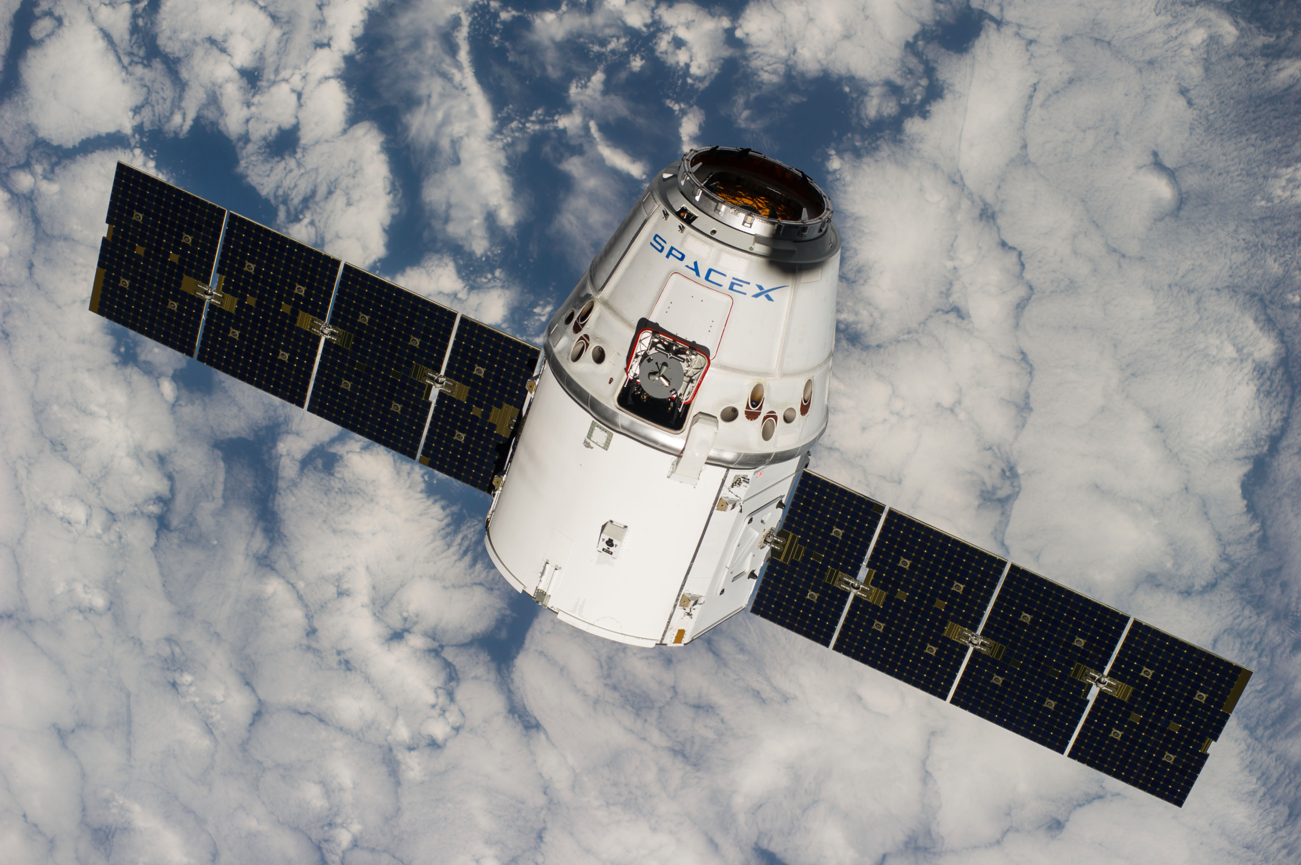
Complex, Remote-Operated Systems
Many types of systems must be teleoperated
Space systems
Underwater ROVs
Robots for radioactive environments
Difficult to troubleshoot
Large amounts of data
Data analysis and visualization becomes difficult
Vehicles such as the Dragon spacecraft have thousands of data channels!

Slide 5
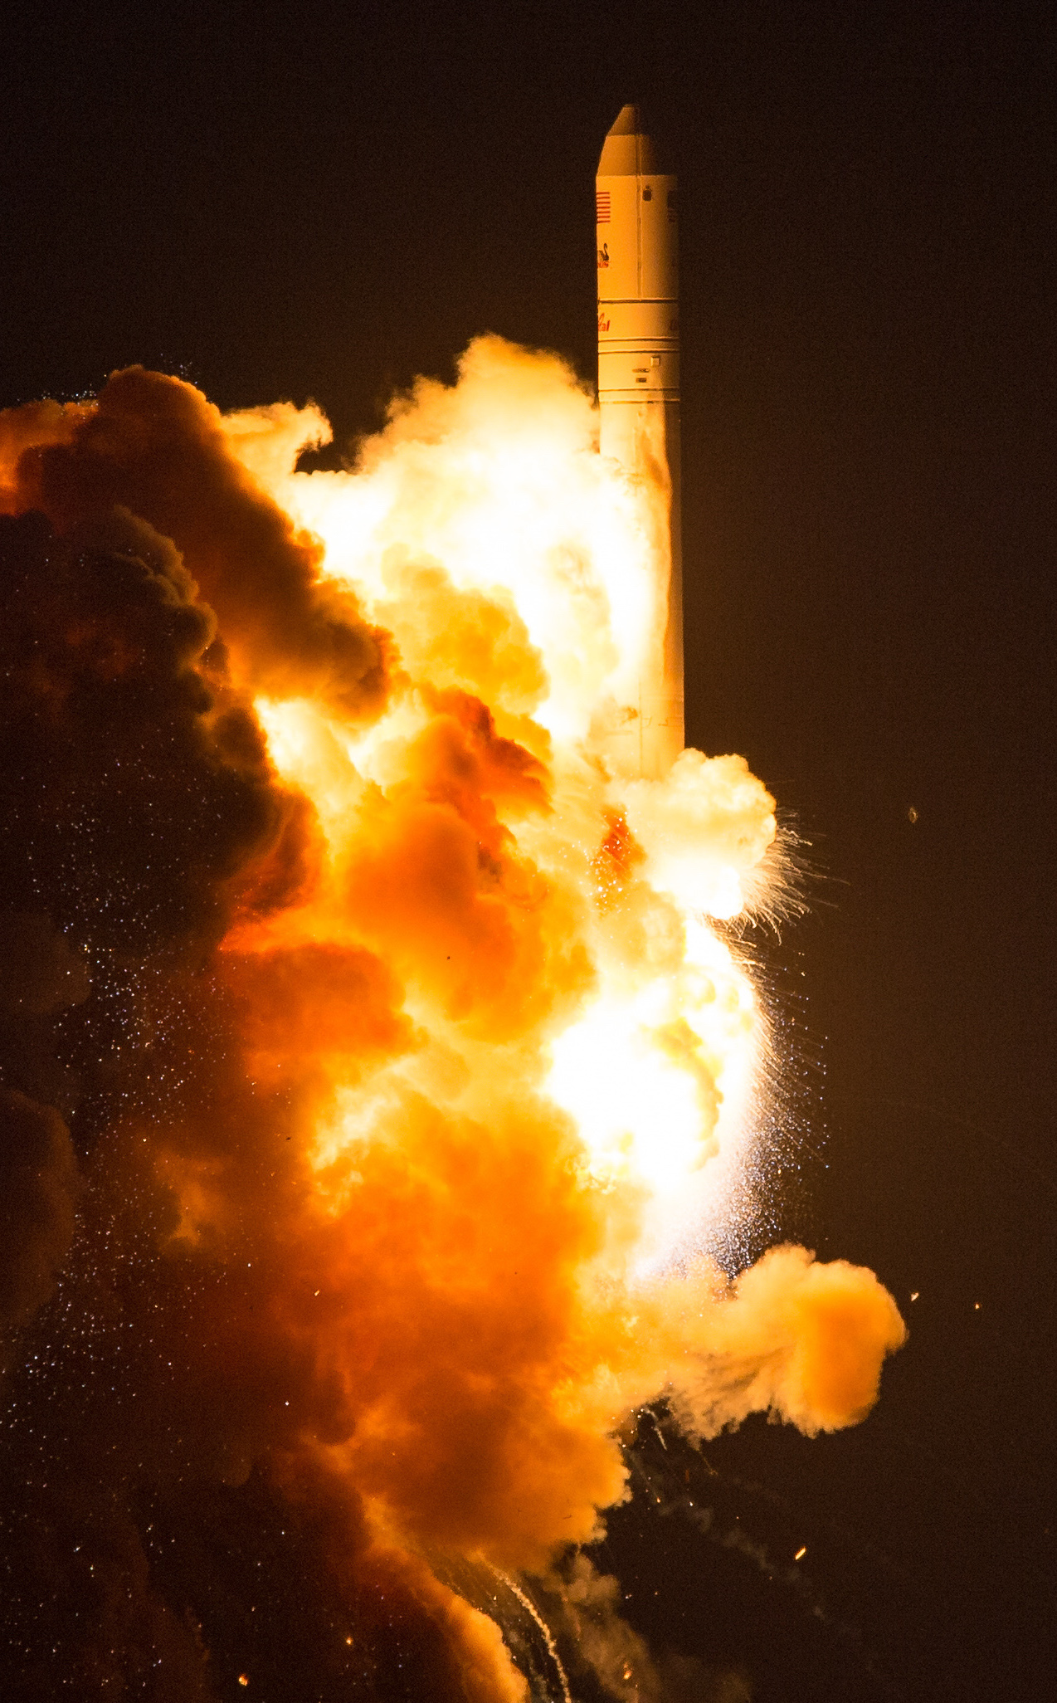
Antares CRS Orb-3
Orbital Sciences October 2014, ISS cargo delivery
Large explosion 6 seconds after launch
Catastrophic failure; cargo completely destroyed
What caused this?
Investigation immediately launched
A week later, problem only vaguely linked to engine (visible in video footage)
Still no conclusive root case given

Slide 6
Root Cause Analysis
Determining root cause for a problem very difficult
Problem detection often doesn’t capture cause
Very human-driven, but tools too simple
Many tools simply consist of plotting data channel time series
Need better analytical tools for linking detected problems to uncaptured causes
Need better human-facing tools to speed up and improve data review

Slide 7
Objectives
Find analytical techniques that can improve root cause detection
Make user-facing tools to improve human insight into system dynamics
Test above techniques on actual aerospace system data
Create integrated solution that improves root cause analysis

Slide 8
Overview
Motivation and Objectives
Model Definition
Fault Detection Background
Correlative Analysis and Visualization Background
Lunar Rover Ground Station Development
Intermediate Testing
2D Embedding Visualizations
Future Work and Conclusion
Acknowledgements
References

Slide 9
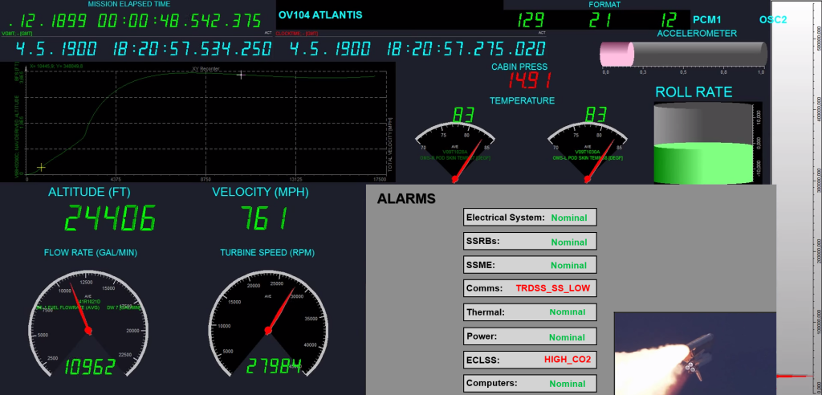
Data Sources
Data streams in discretely from a remote system
This data is “telemetry”
Combination of sensor readings and software metrics
Velocity, acceleration, position, temperature, rotations, attitude, processor usage, dropped packets, etc.
Higher-level telemetry: camera images, spectrograms, etc.
Often thousands of telemetry channels; updates several times per second
Data is received at a “ground station”

Slide 10
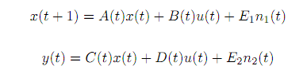
State-Space Model
State modeled discretely:
x(t): system state at time t
y(t): system measurement at time t
u(t): system input at time t
n₁(t) and n₂(t): system disturbance vectors at time t
A(t), B(t), C(t), D(t), E₁(t), E₂(t): linear dynamics
Telemetry data streams in, giving us values for y(t)
Individual elements of y(t) are called telemetry channels

Slide 11
Overview
Motivation and Objectives
Model Definition
Fault Detection Background
Correlative Analysis and Visualization Background
Lunar Rover Ground Station Development
Intermediate Testing
2D Embedding Visualizations
Future Work and Conclusion
Acknowledgements
References

Slide 12
Fault Detection, Isolation, and Recovery (Definitions)
A fault is any system state that is undesirable
FDIR is Fault…
Detection: deciding that a fault occurred
Isolation: determining where the fault occurred
Recovery: restoring the system to a non-faulted state
Normal/expected data is nominal
Otherwise, it’s anomalous
Faults can be divided into fault levels (by severity, or subsystem hierarchy)
Faults can trigger notifications to human operators, called alarms

Slide 13
Alarms

Slide 14
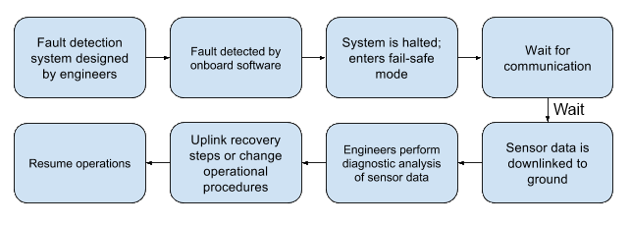
Fault Detection, Isolation, and Recovery (Process)
Many faults cannot be recovered from automatically
Complex issues require human intervention

Slide 15
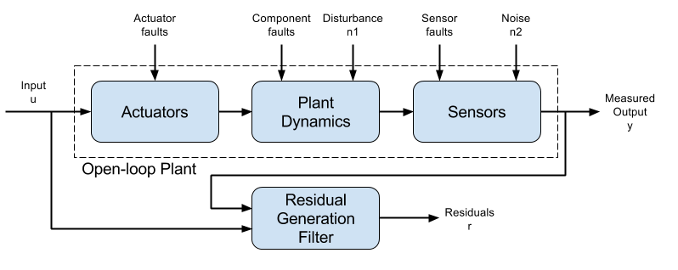
Residual Generation and Fault Detection
Measured output compared to expected system model to find difference
This “residual” used to detect faults
Often, residual simply is a deviation from the expected mean
If residual falls outside a given threshold, a fault may be triggered (e.g., “high acceleration”)

Slide 16
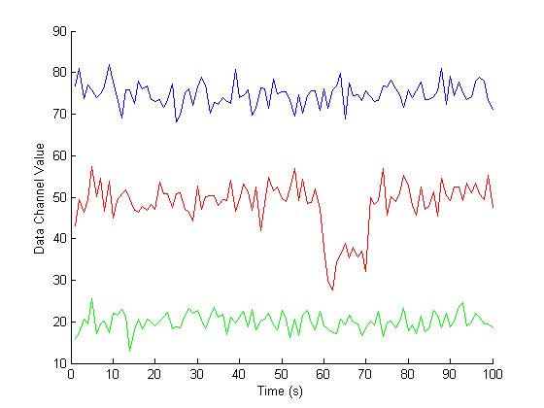
Threshold Fault Detection Example

Slide 17
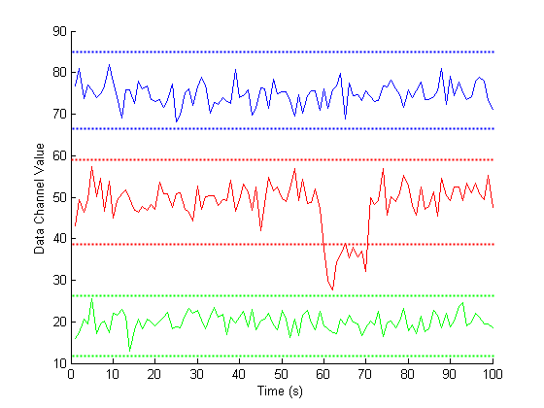
Threshold Fault Detection Example

Slide 18
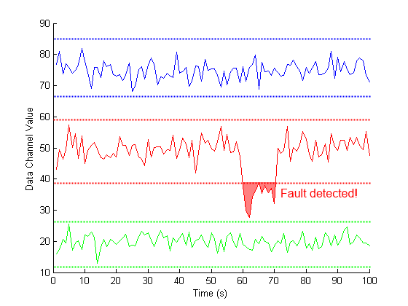
Threshold Fault Detection Example

Slide 19
Other Fault Detection Schemes
Many other types of fault detection
Signal processing
Combinations of complex rules
Probabilistic models
Machine learning from nominal and anomalous data
Redundant hardware systems
We’ll be focusing on models to find deeper root causes which can be agnostic to underlying FD system

Slide 20
Overview
Motivation and Objectives
Model Definition
Fault Detection Background
Correlative Analysis and Visualization Background
Lunar Rover Ground Station Development
Intermediate Testing
2D Embedding Visualizations
Future Work and Conclusion
Acknowledgements
References

Slide 21

Correlative Analysis: Motivation

Slide 22
Covariance

Slide 23
Correlation Metrics

Slide 24
Static Corrgrams

Slide 25
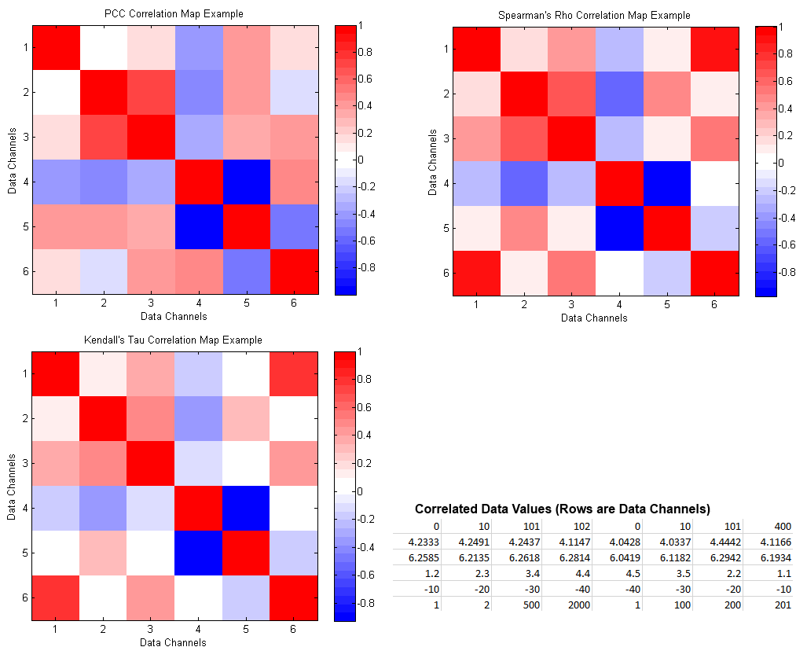
Correlation Metrics: Corrgram Comparison

Slide 26
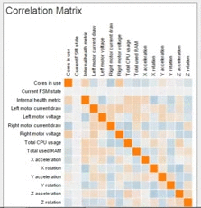

Animated Corrgrams

Slide 27
Overview
Motivation and Objectives
Model Definition
Fault Detection Background
Correlative Analysis and Visualization Background
Lunar Rover Ground Station Development
Intermediate Testing
2D Embedding Visualizations
Future Work and Conclusion
Acknowledgements
References

Slide 28

Hakuto and the Google Lunar XPRIZE
Google Lunar XPRIZE competition
Japanese team “Hakuto”
Based at Tohoku University, Sendai, Japan
Mission to the Moon in 2017
Complete GLXP requirements
Explore lunar caves

Slide 29
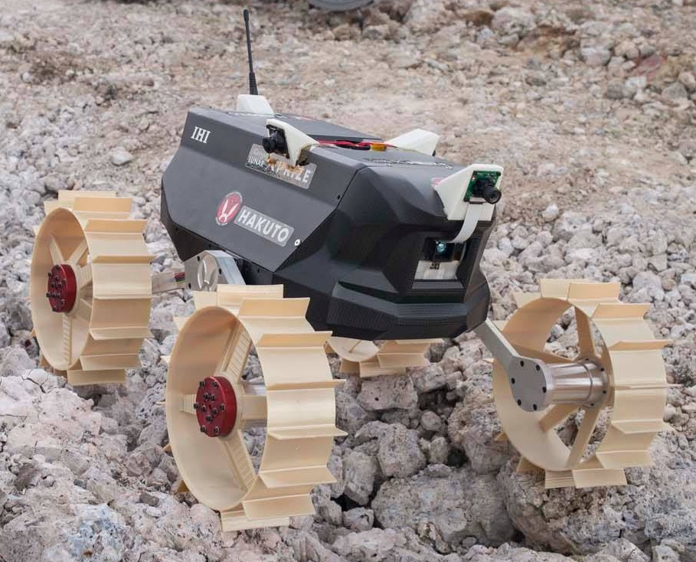
Moonraker Rover
Four-wheeled, 4kg micro-rover
In development since 2010
Four visible-spectrum cameras, 1 depth camera
Many other sensors
~112 telemetry channels
August 2015: Pre-Flight Model 2 development

Slide 30
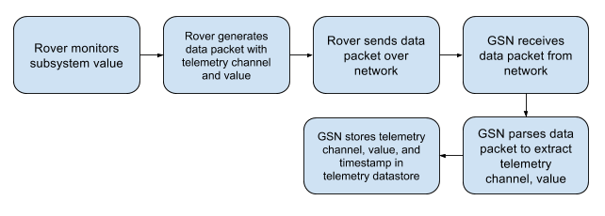
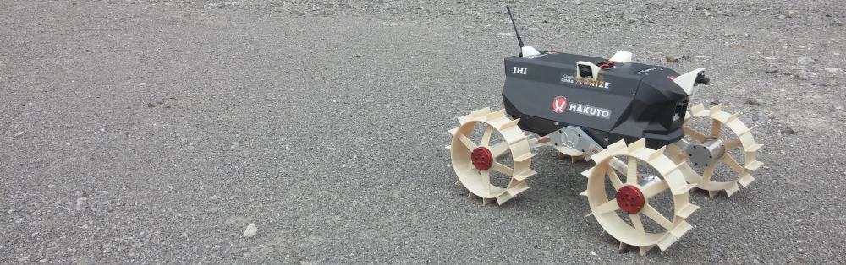
Rover Data Flow

Slide 31
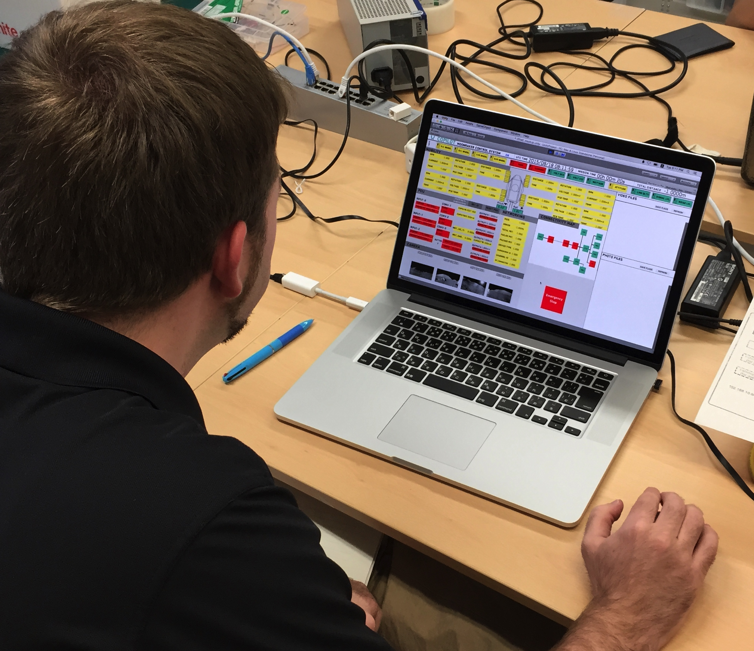
Ground Station Development
Interface for communicating with Moonraker
New system from scratch
Priorities
Easy to understand
Easy commanding
Robust to human error
Maintainable
Unity 3D game engine

Slide 32
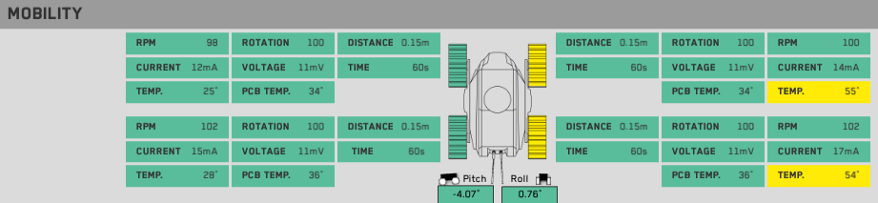
GSN Feature: Telemetry Display
Telemetry displayed on the screen when received from rover
Telemetry grouped by subsystem

Slide 33
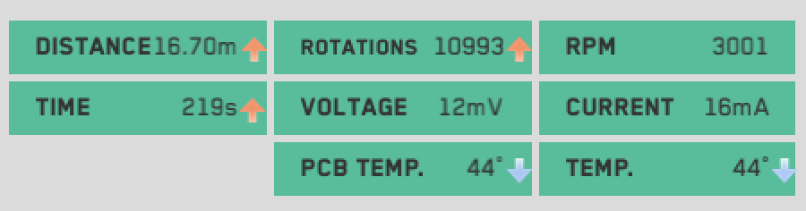
GSN Feature: Telemetry Change Indicators
Telemetry trends shown with arrow-based change indicator system

Slide 34
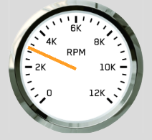
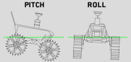
GSN Feature: Tachometer/Attitude Display
Pitch and roll
Calculated from accelerometer telemetry
Shown with 2D rotation of a virtual Moonraker
RPM
Averaged from four-wheel motor telemetry
Shown as an indicator on a virtual tachometer

Slide 35
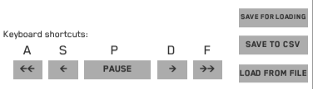
GSN Feature: Saving/Loading/Playback
Incoming telemetry can be paused
Can scrub back and forth through received data
Data can be saved/loaded, or exported to .csv format

Slide 36
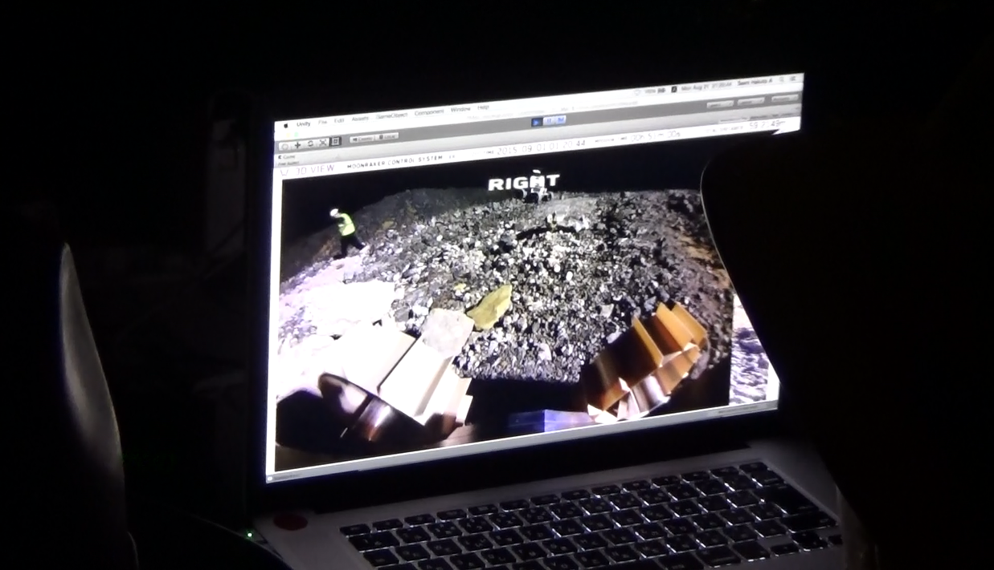
Immersive 3D View
User can rotate a camera inside a virtual 3D room
Each of the four “walls” shows a camera image
Gives intuitive understanding of environment

Slide 37
Threshold-Basic Fault Detection
Telemetry channels are grouped at the top of the screen
Telemetry values exceeding warning/danger thresholds are clearly shown on the screen
Faults in a group trigger its alert panel to change color

Slide 38
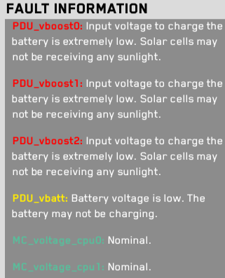
Detailed Fault Information
Fault-specified data shown for selected channels
Detailed descriptions can be provided
Allows for knowledge transfer from experienced operators

Slide 39
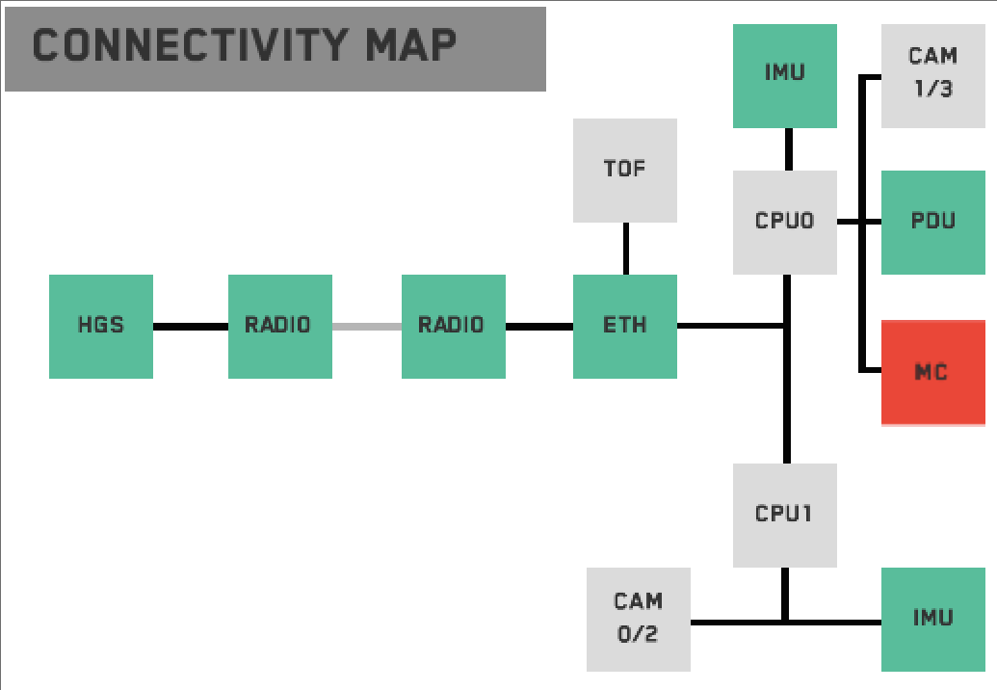
Connectivity Map
Visual display to show current status of modules
Modules change color to reflect how recently they’ve been heard from

Slide 40
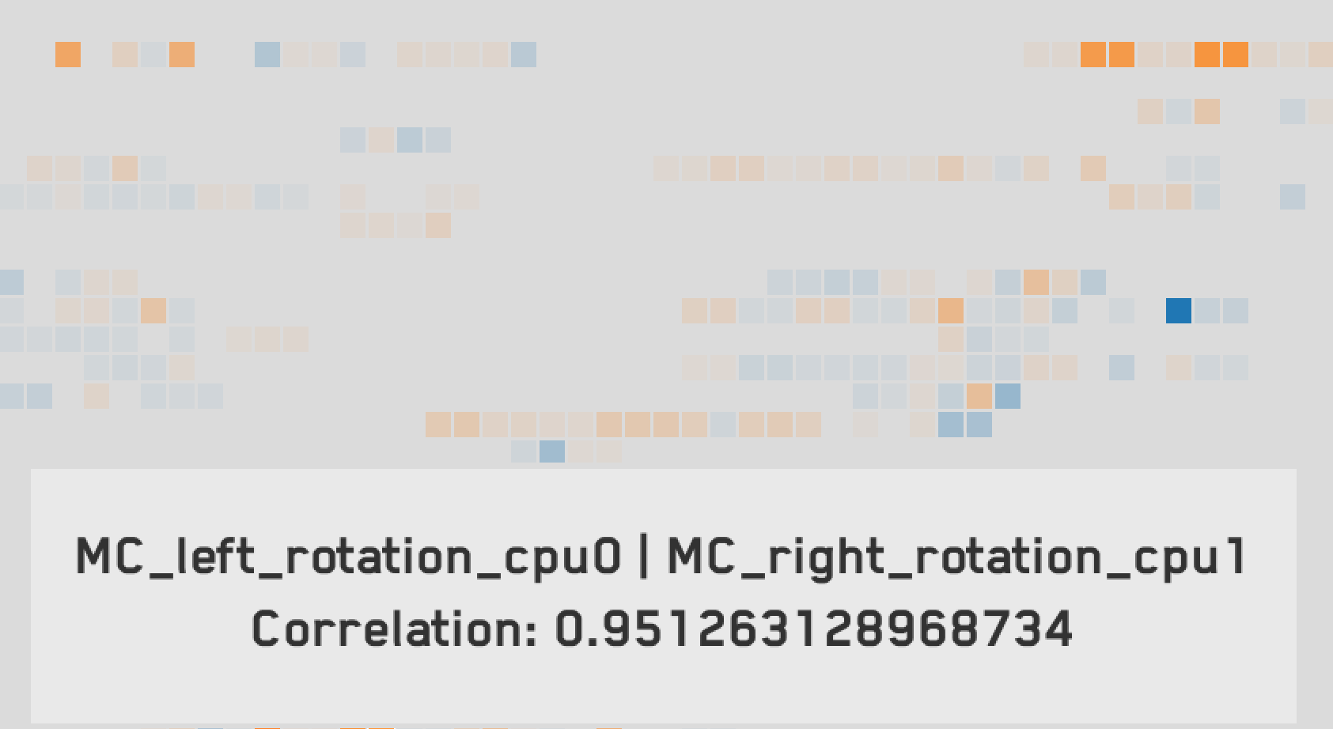
Animated Corrgram
2D grid of blocks
Each block shows the correlation between two channels (within retrospective time window)
PCC correlation score shown as hue:
High positive correlation: orange
High negative correlation: blue
Grid updated with latest correlations from incoming telemetry

Slide 41
Animated Corrgram Screenshot

Slide 42
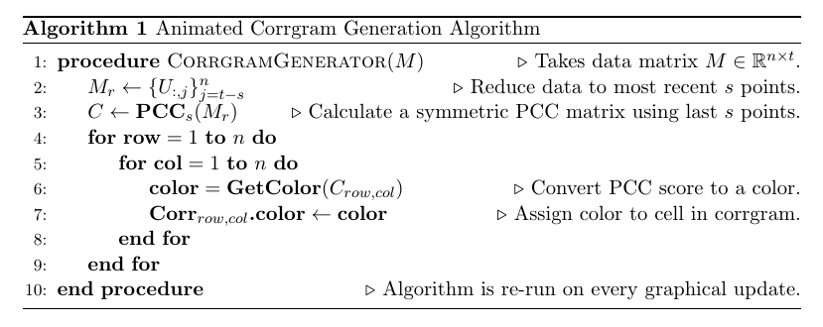
Animated Corrgram Implementation

Slide 43
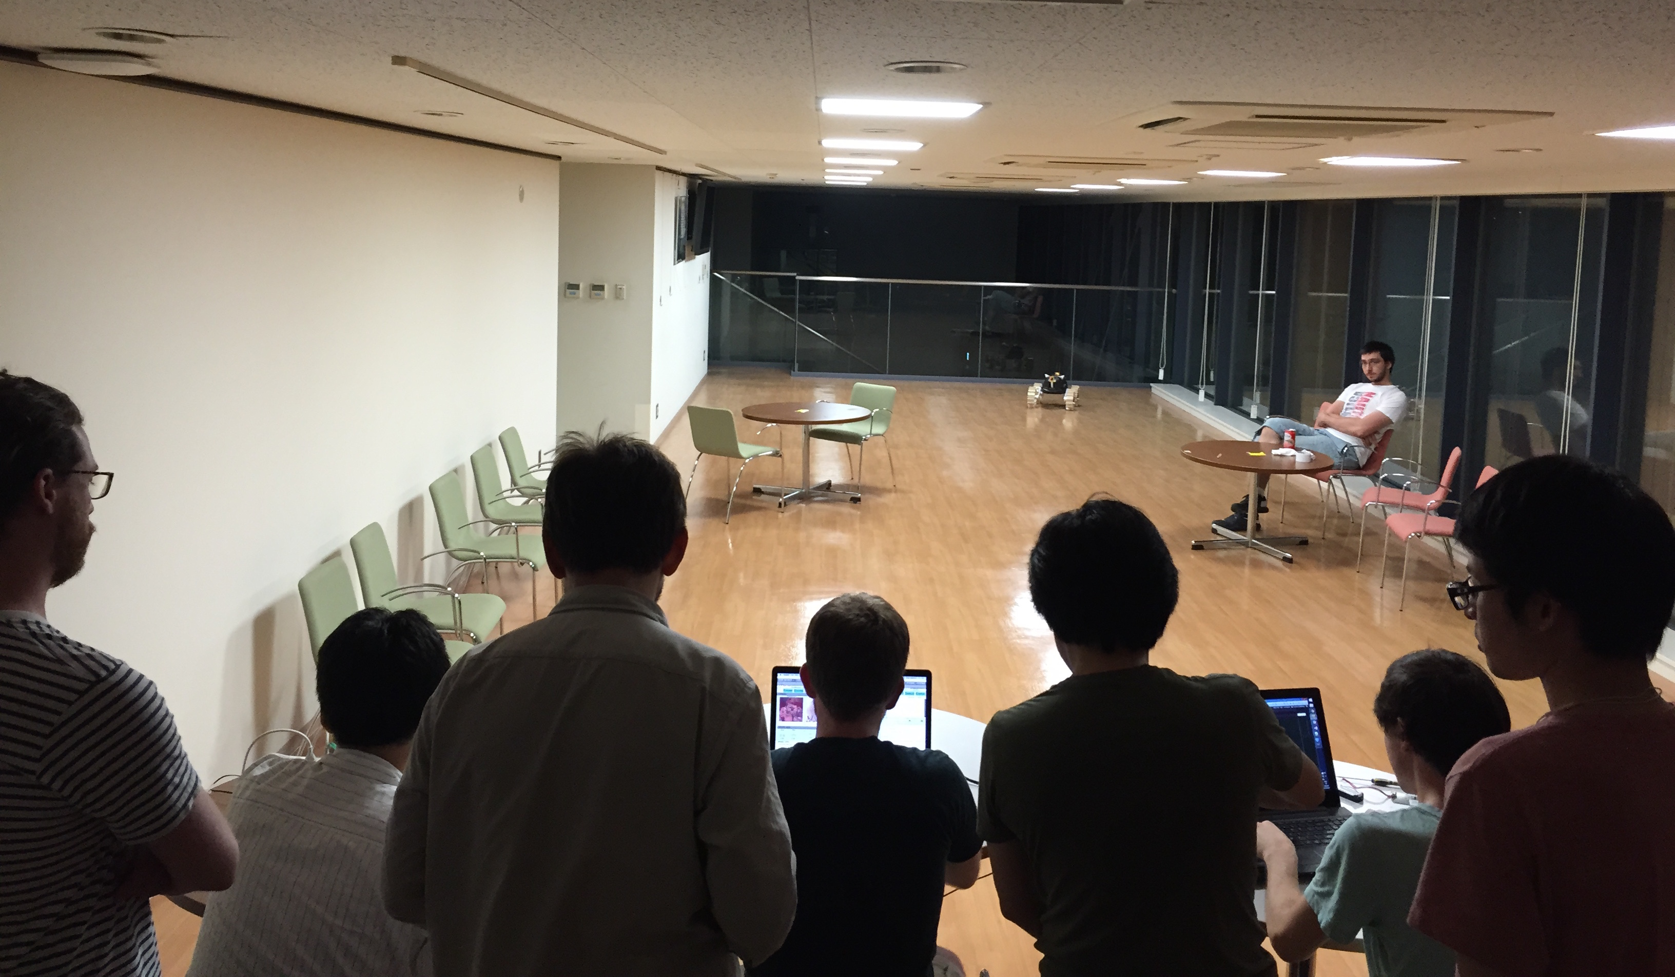
First Integration

Slide 44
Overview
Motivation and Objectives
Model Definition
Fault Detection Background
Correlative Analysis and Visualization Background
Lunar Rover Ground Station Development
Intermediate Testing
2D Embedding Visualizations
Future Work and Conclusion
Acknowledgements
References

Slide 45
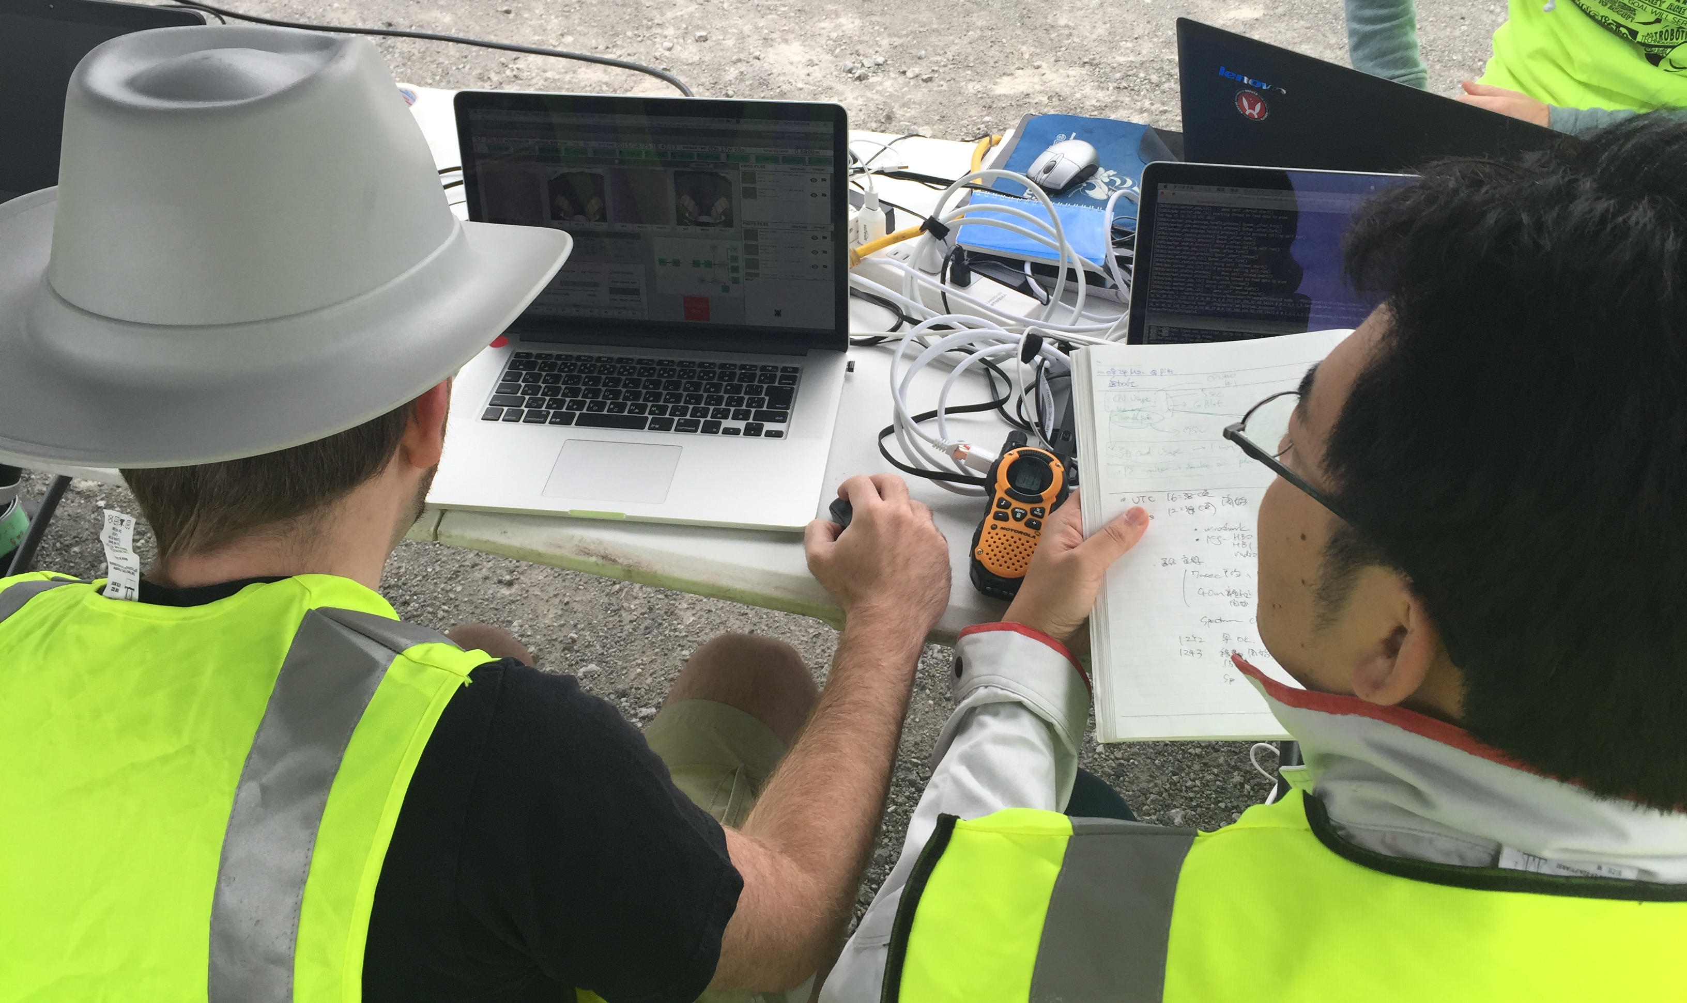
Pittsburgh Field Testing
Six Hakuto engineers went to Pittsburgh in August 2015
Field tests with Hakuto launch partner Astrobotic
Two main goals
V&V of radio comm. system through Astrobotic lander
Mobility and software tests of PFM2 rover
Tested rover on moon-like terrain (rock quarry)
Did tests in lunar lighting-like conditions
Controlled Moonraker from my ground station for all tests

Slide 46
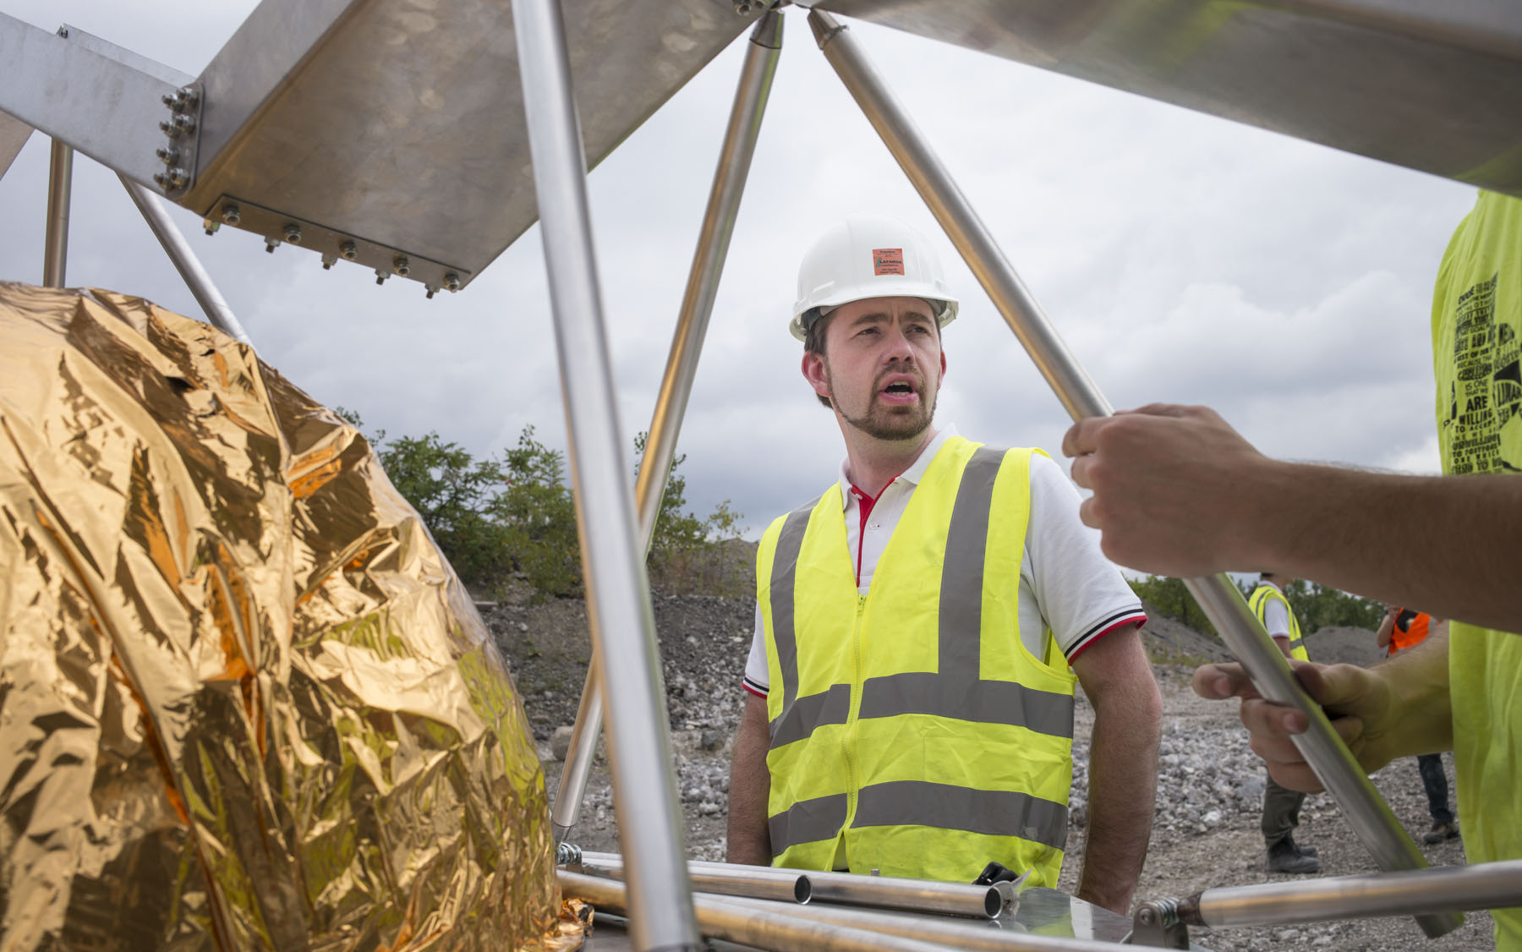
Pittsburgh Field Testing

Slide 47
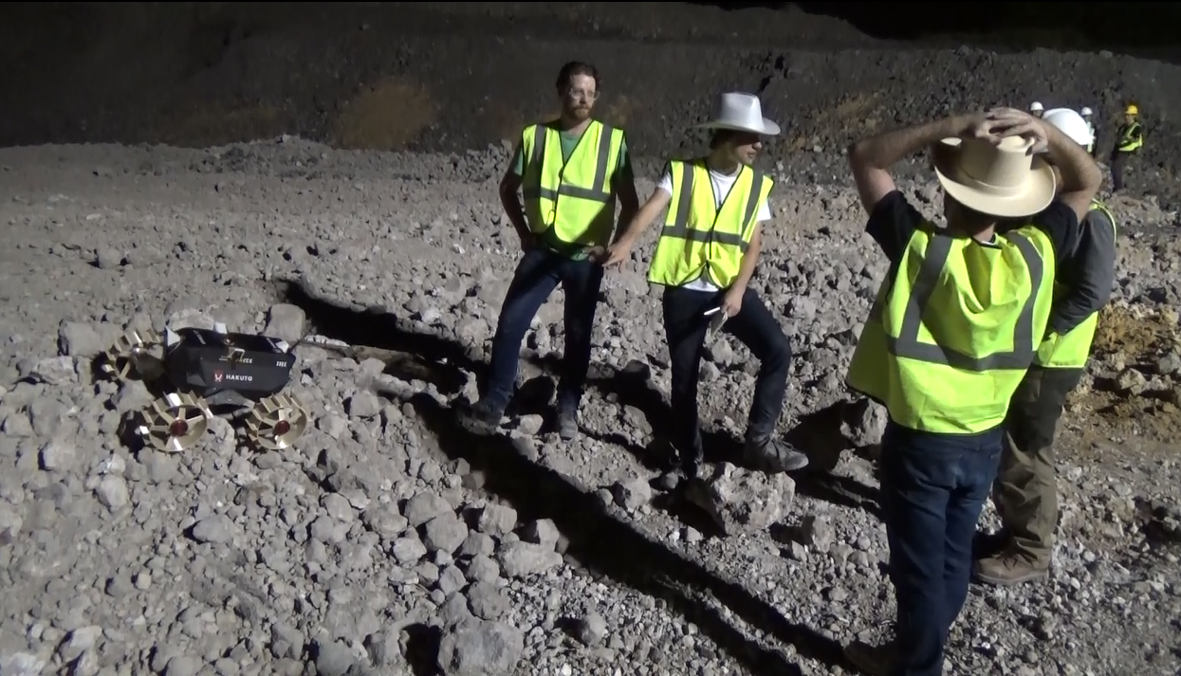
Pittsburgh Field Testing Results
Promising results
Mobility goals successful
Motor controller improvement
Found many software bugs to fix
“Immersive viewing” very useful
“Connectivity map” excellent for troubleshooting
User attention issues

Slide 48
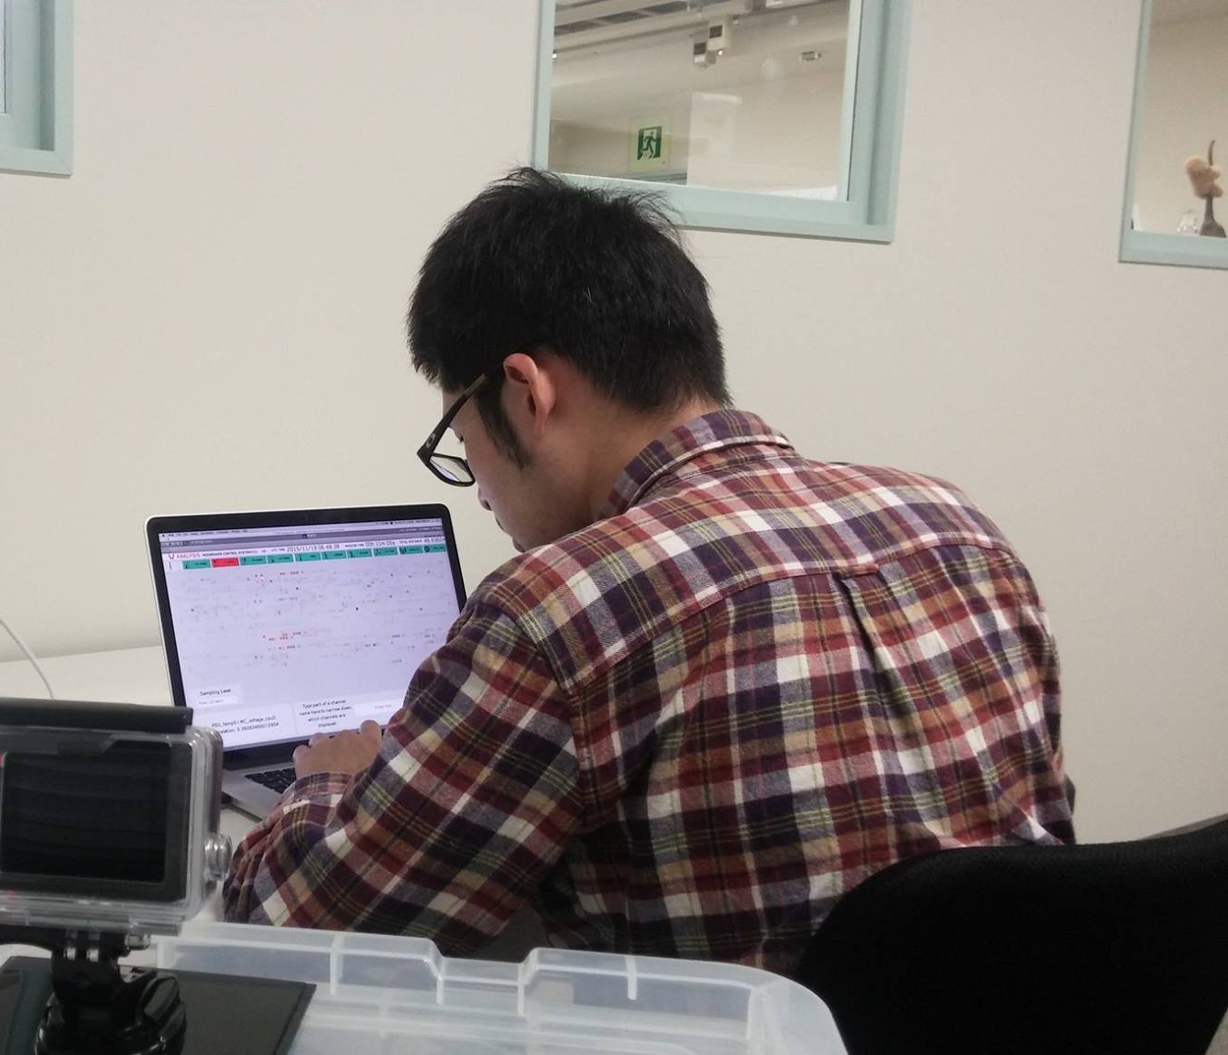
Ground Station Usability Testing Overview
November 2015 testing to find usability issues
Emphasize on data monitoring, analysis
Seven participants
All without extensive GSN experience
10-minute simulated Moonraker lunar run
Each user watched this telemetry and analyzed it
Users told story of what happened

Slide 49
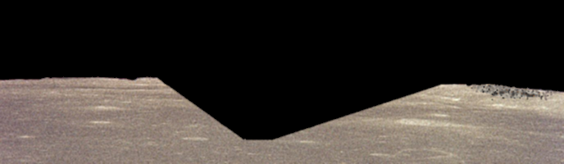
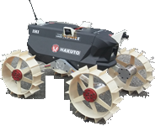
Usability Testing Events
0s: Rover begins traveling forward along smooth terrain.

Slide 50
Usability Testing Events
188s: Rover begins descending into crater.

Slide 51
Usability Testing Events
223s: Rover loses line of sight with lander and packet drops begin.

Slide 52
Usability Testing Events
287s: Rover enters shade, causing temp, comms, and power drops.

Slide 53
Usability Testing Events
300s: Rover begins traversing smooth bottom of crater.

Slide 54
Usability Testing Events
330s: Rover begins climbing out of crater.

Slide 55
Usability Testing Events
343s: Rover exits shade; rover continues uphill.

Slide 56
Usability Testing Events
534s: Rover emerges from crater and enters smooth terrain.

Slide 57
Usability Testing Events
594s: Rover enters choppy terrain.

Slide 58
Usability Testing Events
643s: Rover wheel has fault; rover stops moving.

Slide 59
Usability Testing Results

Slide 60
Testing Takeaways

Slide 61
Overview
Motivation and Objectives
Model Definition
Fault Detection Background
Correlative Analysis and Visualization Background
Lunar Rover Ground Station Development
Intermediate Testing
2D Embedding Visualizations
Future Work and Conclusion
Acknowledgements
References

Slide 62
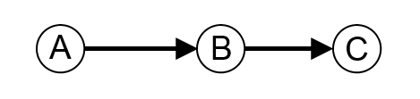
Undirected Correlation Graphs
Start with dependency graph
2D embedding where dependency represented with edge directions
A depends on B; B depends on C:
Variation: undirected graph where edges indicate correlation (each node is a data channel)

Slide 63
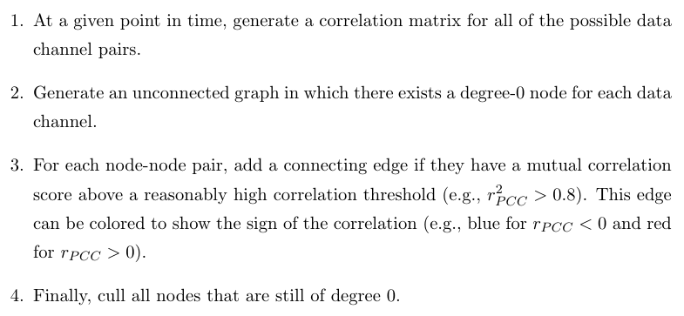
Applying Undirected Correlation Graphs

Slide 64
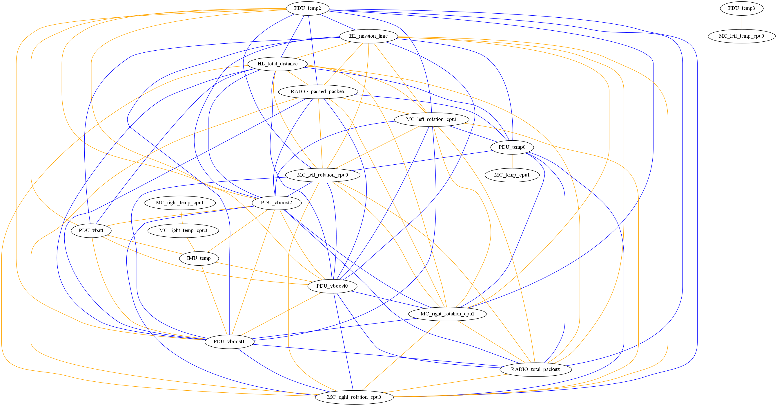
UCGs: Full Correlation

Slide 65
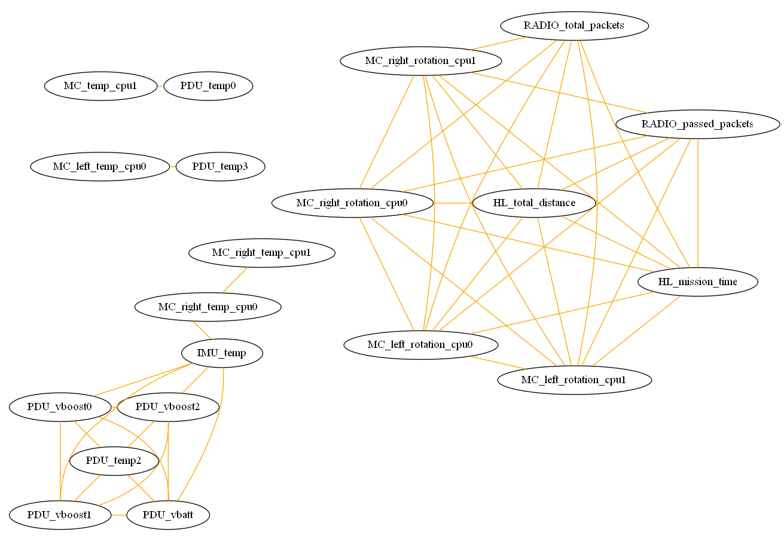
UCGs: Positive Correlations Only

Slide 66
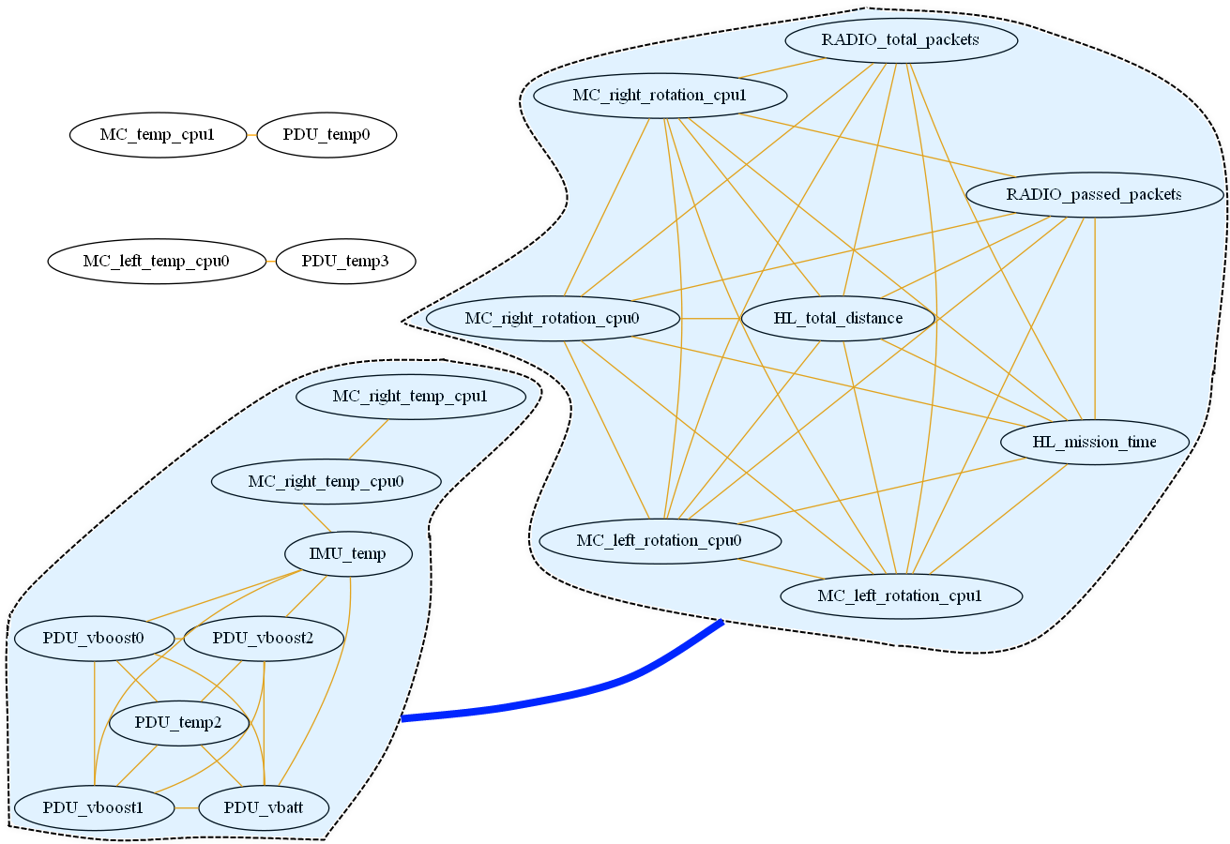
UCGs: Positive Correlations with Cluster Correlations

Slide 67
Observations
Correlations can be understood at a glance
Positive correlations most intuitive
Clustering very useful
Low-degree subgraphs worthy of second look
Doesn’t capture correlative state over time (needs to be animated)

Slide 68
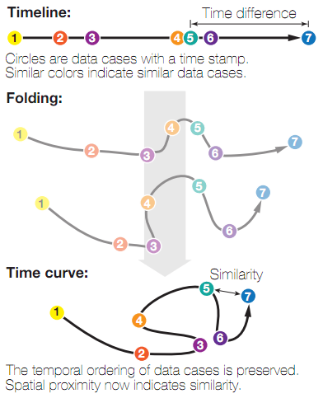
Time Curves
Bach et al. algorithm from 2015
Constructs 2D embedding showing changing system state over time
Uses a set of “time points” and data about their distances to make a graph embedding that shows distance between states while maintaining temporal ordering

Slide 69
Advantages of Time Curves
Show clustering
Visualize cycles
Emphasize transitions
Extensible

Slide 70
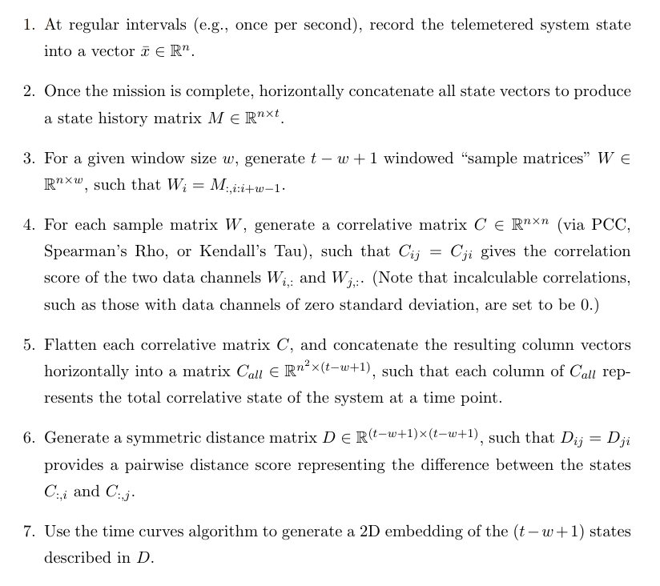
Applying Time Curves

Slide 71
Time Curve Data to Visualize
Used simulated rover data (based closely on real telemetry)
0
1
7
8
9
2
3
6
4
5

Slide 72
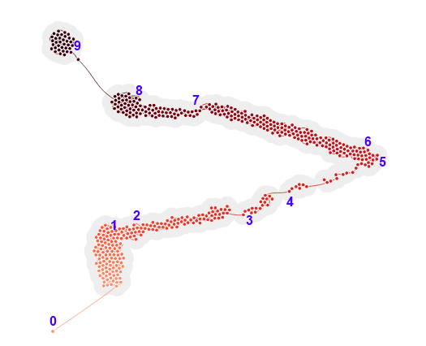
Time Curves on Raw Telemetry State Data

Slide 73
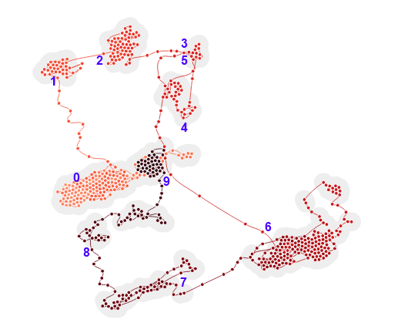
Time Curves on PCC Correlation State

Slide 74
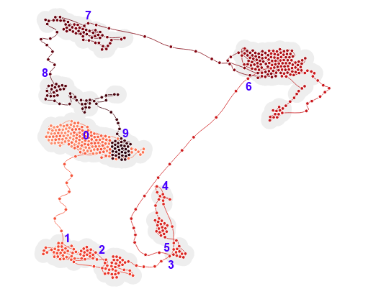
Time Curves on Rho Correlation State

Slide 75
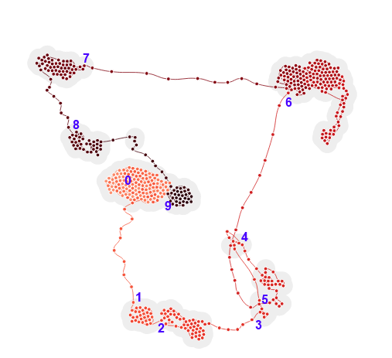
Time Curves on Tau Correlation State

Slide 76
Observations
Show varying operational modes
Viewer can easily follow state progression
Major moves correspond cleanly to actual timestamps
Correlative analysis progression easier to understand
Monotonicity in raw telemetry
Internal system relationships (rather than environmental ones) more easily captured by correlative analysis
Rank correlative measures better than PCC
May be related to PCC’s assumptions of linearity and continuous variable types
Able to “discover” unique state that aren’t expected (e.g., comms loss in state #2)
Very promising and capable of suggesting correlative changes

Slide 77
Overview
Motivation and Objectives
Model Definition
Fault Detection Background
Correlative Analysis and Visualization Background
Lunar Rover Ground Station Development
Intermediate Testing
2D Embedding Visualizations
Future Work and Conclusion
Acknowledgements
References

Slide 78
Further Work
Integrate visualizations
Connect visualizations
Use data channels at portals
Bring more into realtime
Work with more data sets
Re-test usability

Slide 79
Conclusion
Built ground station for real aerospace system
Incorporated high-level FDIR troubleshooting
V&V’ed in 100+ hours of field testing and usability testing
Built analytical system to find correlative state
Created three new types of correlative visualizations
Showed that these visualizations give insights that hold up to scrutiny
Tools show promise for future troubleshooting

Slide 80
Overview
Motivation and Objectives
Model Definition
Fault Detection Background
Correlative Analysis and Visualization Background
Lunar Rover Ground Station Development
Intermediate Testing
2D Embedding Visualizations
Future Work and Conclusion
Acknowledgements
References

Slide 81
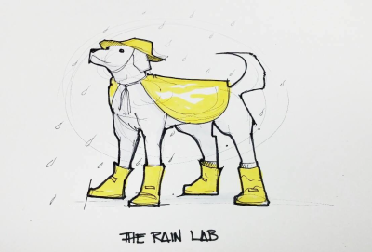

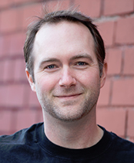





Acknowledgements

Slide 82
Overview
Motivation and Objectives
Model Definition
Fault Detection Background
Correlative Analysis and Visualization Background
Lunar Rover Ground Station Development
Intermediate Testing
2D Embedding Visualizations
Future Work and Conclusion
Acknowledgements
References

Slide 83
References

Slide 84
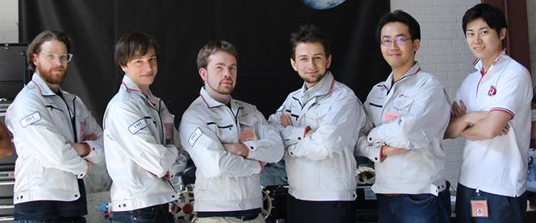
Thank you!
Questions?

